Slide 3
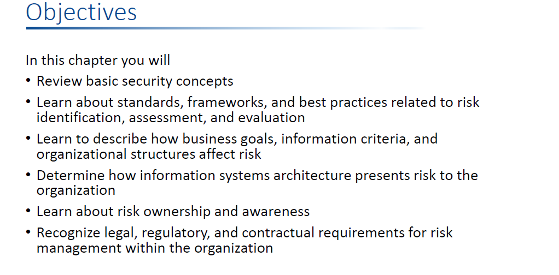

Slide 19
Vulnerabilities
list of vulnerabilities – this is not a definitive list, it must be adapted to the individual organization:
Complicated user interface
Default passwords not changed
Disposal of storage media without deleting data
Equipment sensitivity to changes in voltage
Equipment sensitivity to moisture and contaminants
Equipment sensitivity to temperature
Inadequate cabling security
Inadequate capacity management
Inadequate change management
Inadequate classification of information
Inadequate control of physical access
Inadequate maintenance
Inadequate network management
Inadequate or irregular backup
Inadequate password management
Lack of policy for the use of cryptography
Inadequate physical protection
Inadequate protection of cryptographic keys
Inadequate replacement of older equipment
Inadequate security awareness
Inadequate segregation of duties
Inadequate segregation of operational and testing facilities
Inadequate supervision of employees
Inadequate supervision of vendors
Inadequate training of employees
Incomplete specification for software development
Insufficient software testing
Lack of access control policy
Lack of clean desk and clear screen policy
Lack of control over the input and output data
Lack of internal documentation
Lack of or poor implementation of internal audit
Lack of procedure for removing access rights upon termination of employment
Lack of protection for mobile equipment
Lack of redundancy
Lack of systems for identification and authentication
Lack of validation of the processed data
Location vulnerable to flooding
Poor selection of test data
Single copy
Too much power in one person
Uncontrolled copying of data
Uncontrolled download from the Internet
Uncontrolled use of information systems
Undocumented software
Unmotivated employees
Unprotected public network connections
User rights are not reviewed regularly

Slide 21
Catalogue of threats
This list of threats and vulnerabilities can serve as a help for implementing risk assessment
each organization must add their own specific threats and vulnerabilities that endanger the confidentiality, integrity and availability of their assets.
Threats
Below is a list of threats – this is not a definitive list, it must be adapted to the individual organization:
Disclosure of passwords
Eavesdropping
Access to the network by unauthorized persons
Bomb threat
Breach of contractual relations
Breach of legislation
Compromising confidential information
Concealing user identity
Damage caused by a third party
Damages resulting from penetration testing
Destruction of records
Disaster (human caused)
Disaster (natural)
Disclosure of information
Errors in maintenance
Failure of communication links
Falsification of records
Fire
Flood
Fraud
Industrial espionage
Information leakage
Interruption of business processes
Loss of electricity
Loss of support services
Malfunction of equipment
Malicious code
Misuse of information systems
Misuse of audit tools
Pollution
Social engineering
Software errors
Strike
Terrorist attacks
Theft
Thunderstroke
Unintentional change of data in an information system
Unauthorized access to the information system
Unauthorized changes of records
Unauthorized installation of software
Unauthorized physical access
Unauthorized use of copyright material
Unauthorized use of software
User error
Vandalism

Slide 27
